Slide 1


Tailor Shop DEI
A new way of experiencing tailoring
Web Application
Laurea Magistrale in Ingegneria Informatica, Master Degree in ICT for Internet and Multimedia
Dallapellegrina Elia, Friso Luca, Golmohammadi Pargol, Grimaldi Alberto, Mjama Anass

Slide 2
Introduction
What are the characteristics of our web application?
What is our goal?
Simplicity of use
Responsive design
Facilitate management
Web Application
Academic Year 2020-2021
Dallapellegrina Elia, Friso Luca, Golmohammadi Pargol,
Grimaldi Alberto, Mjama Anass
Notes:
Our goal is to help a new tailor shop to be more competitive on the online market by creating a web application that allows you to keep track of orders, manage employees, customer requests and in particular give greater visibility to the products and services offered by the tailor. In this way we want to make the entire production chain more efficient, starting from the simple request by the customer up to the realization of the finished product.
Characteristics:
simplicity of use: everybody must be able to use this web app
Responsive design: we want to adact our web app to every possible device or most of them
facilitate management: because we want to offer the best user experience both from customer side and employee or manager side

Slide 3
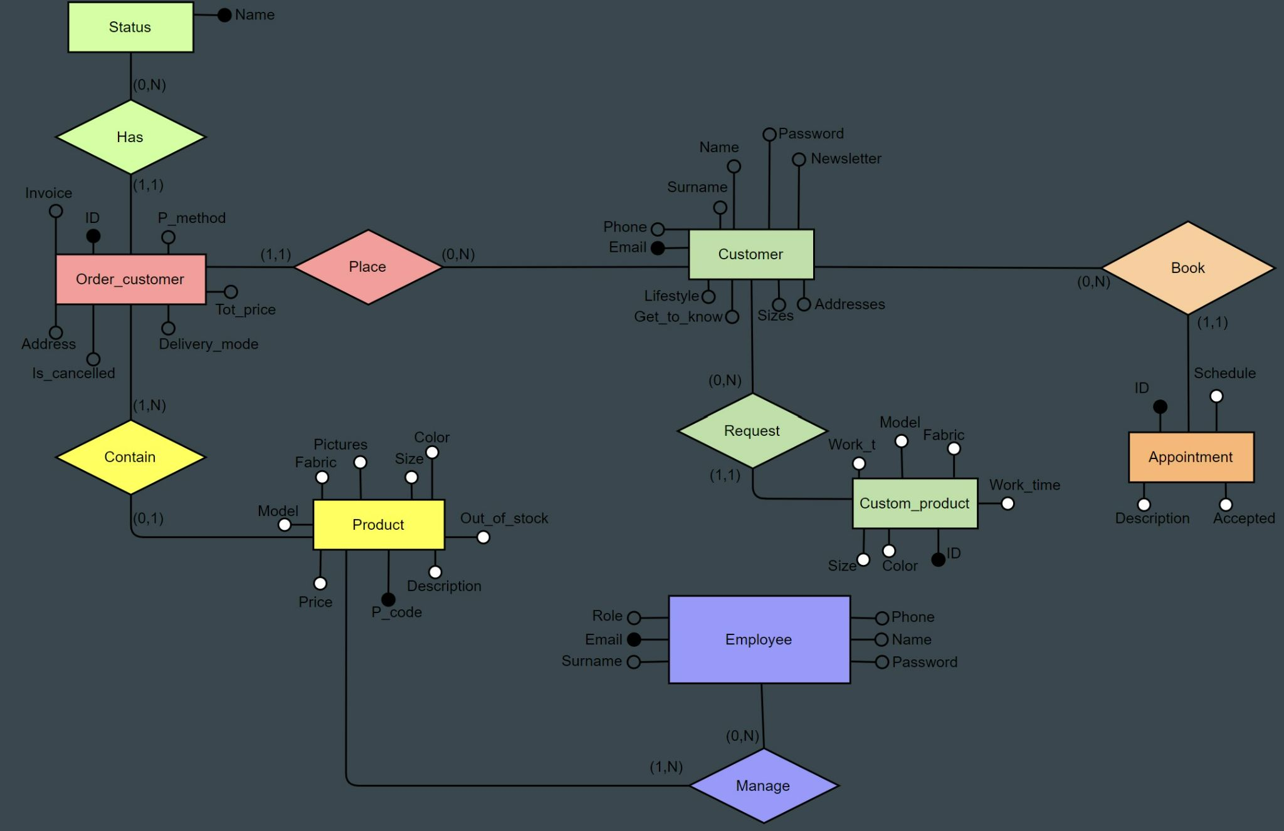
Database
Web Application
Academic Year 2020-2021
Dallapellegrina Elia, Friso Luca, Golmohammadi Pargol,
Grimaldi Alberto, Mjama Anass
Notes:
This is our ER schema
2 main side
Customer side che comprende le entity customer con chiave primaria l’ email, order_customer e appointment identificate da un intero with autoincremnt:
Un customer può registrarsi alla webapp, piazzare un ordine contenente uno prodotto at a time e prenotare un appuntamento per richiedere riparazioni or just to agree the details about a customized product
Employee side che comprende le entity employee, product
Un employee può gestire gli ordini dei clienti, i profili dei customer e gli appuntamenti. Ogni employee è caratterizzato da un ruolo che può essere un semplice impiegato o un manager il quale in più può registrare e modificare l’account di un employee.

Slide 4
Servlet
REST
Customer
Manager
Product
Order
Appointment
Web Application
Academic Year 2020-2021
Dallapellegrina Elia, Friso Luca, Golmohammadi Pargol,
Grimaldi Alberto, Mjama Anass

Slide 5
Filter
Method used:
doFilter → This method is called by the container each time a request/response pair is passed through the chain due to a client request for a resource at the end of the chain
Filtered page:
shop page
creation of a custom product
book an appointment
Web Application
Academic Year 2020-2021
Dallapellegrina Elia, Friso Luca, Golmohammadi Pargol,
Grimaldi Alberto, Mjama Anass

Slide 6
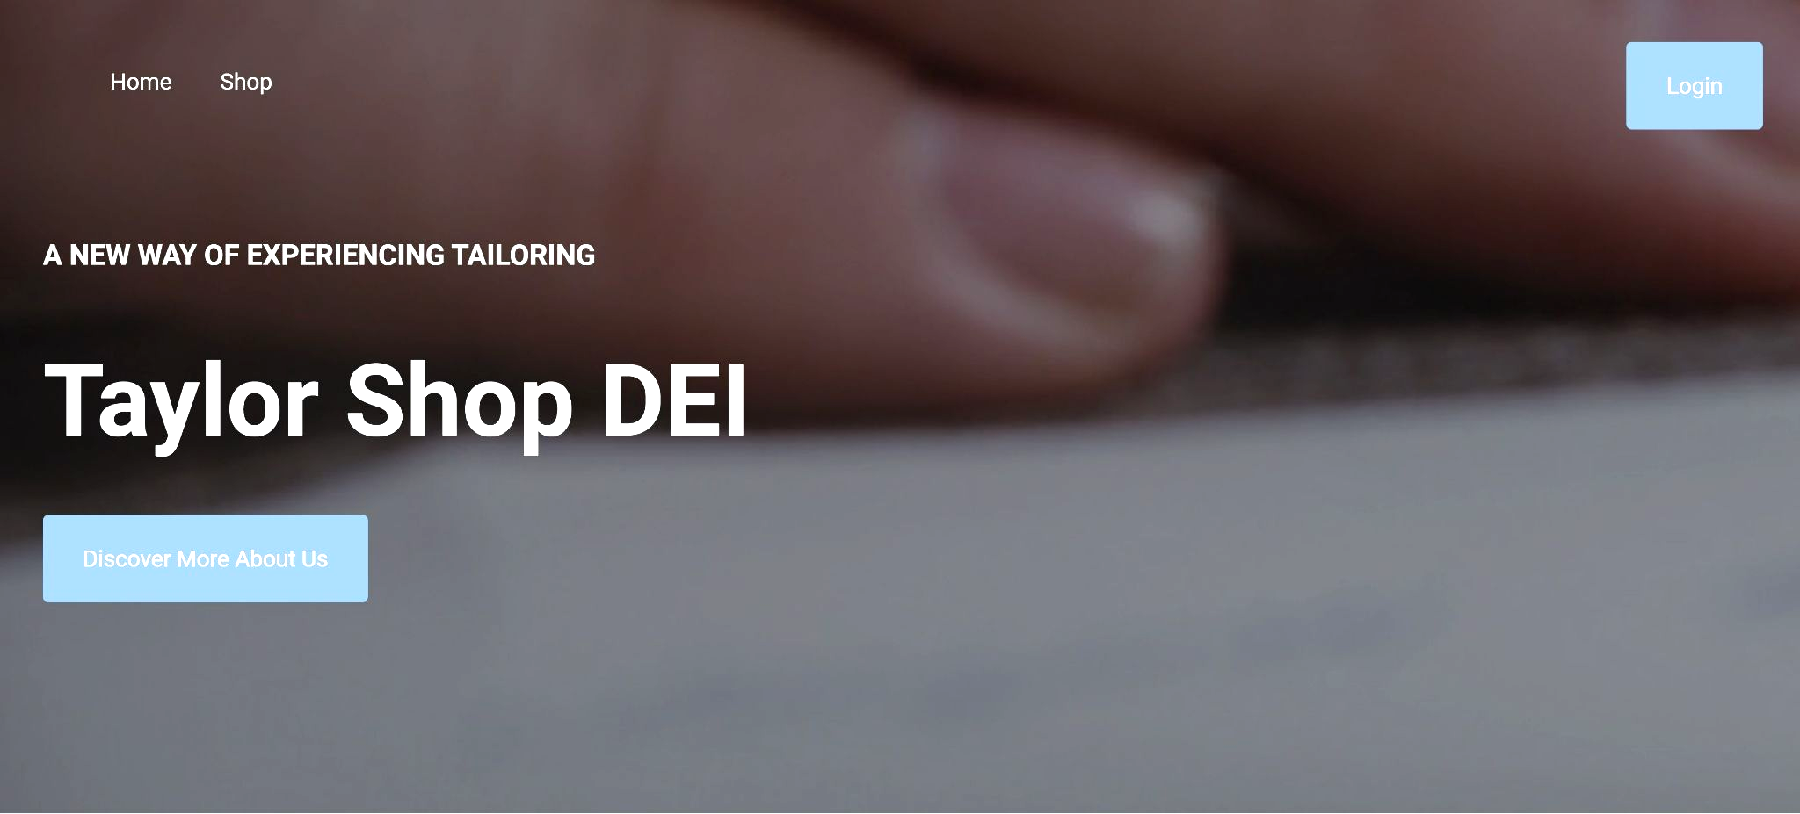
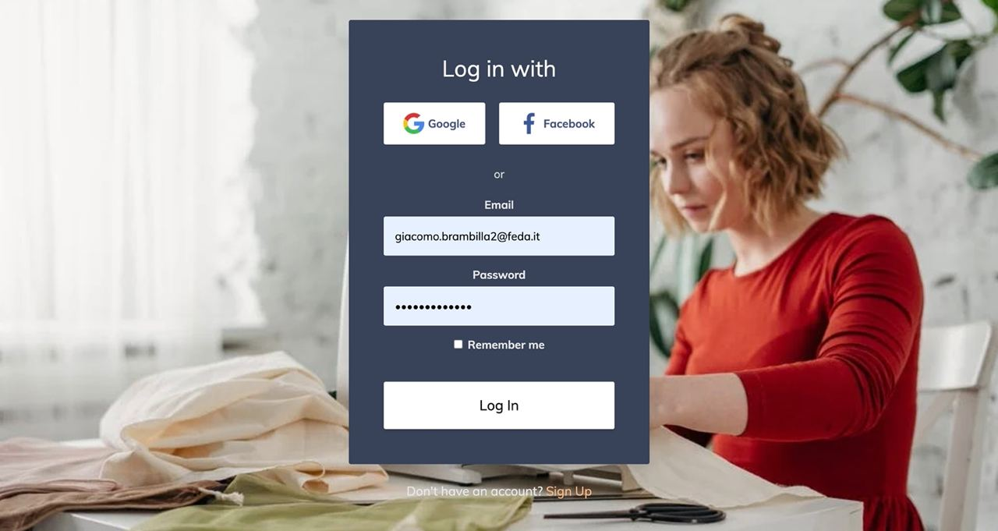
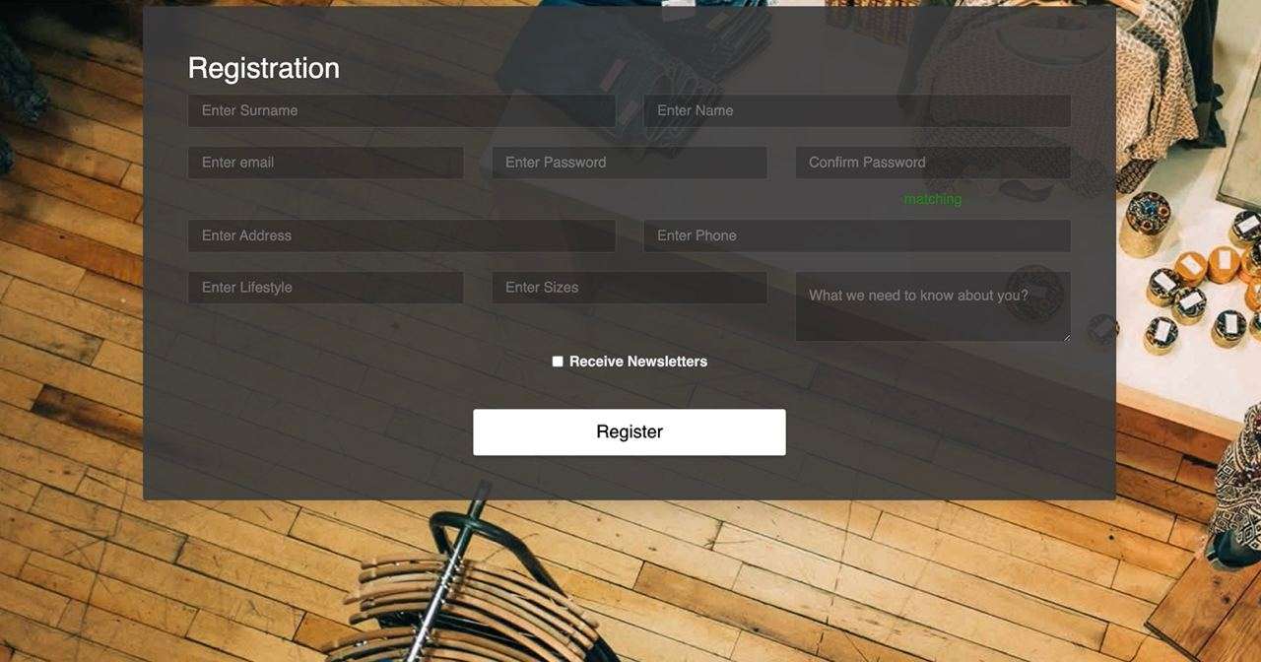
Frontend - Client Side 1
From the homepage the user can:
Login or
register
Access the
shop
Create a
custom product
Book an appointment
Web Application
Academic Year 2020-2021
Dallapellegrina Elia, Friso Luca, Golmohammadi Pargol,
Grimaldi Alberto, Mjama Anass

Slide 7
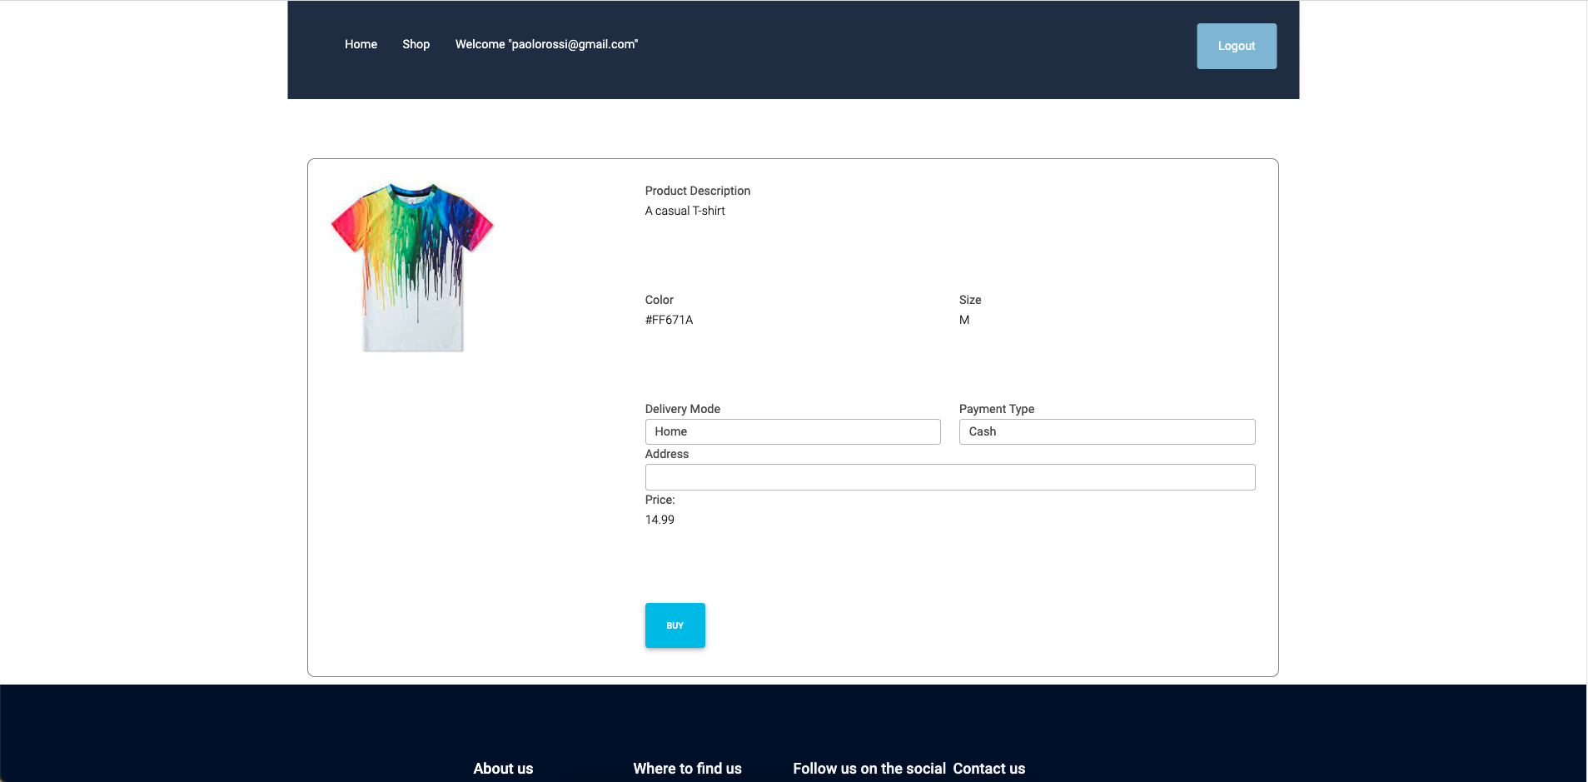
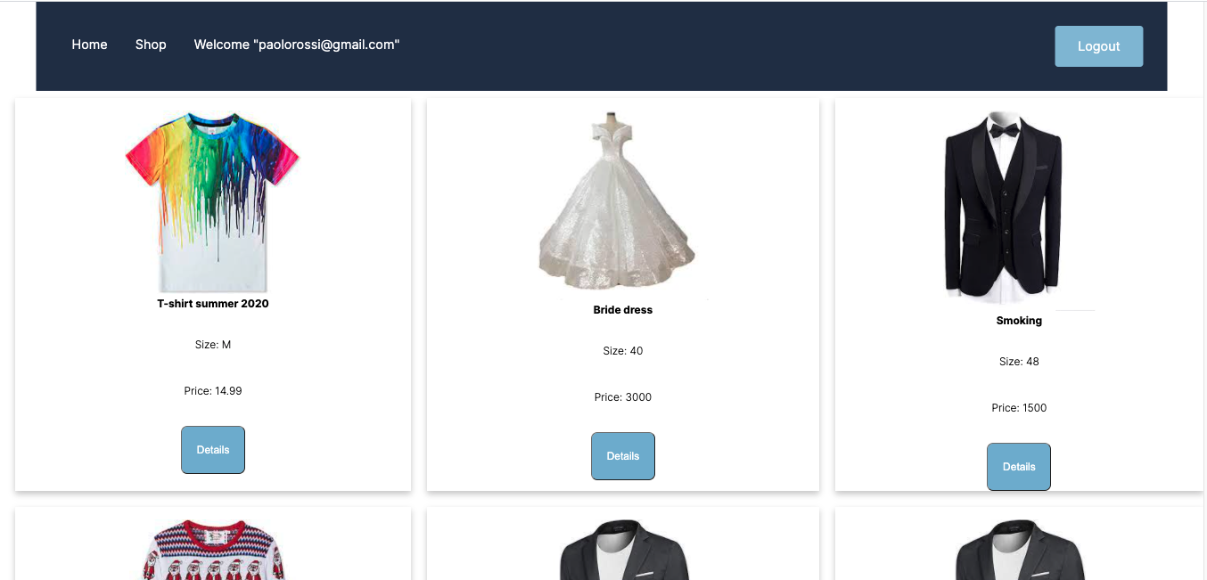
Frontend - Client Side 2
Shop homepage
Dynamically create
Adaptive size
Web Application
Academic Year 2020-2021
Dallapellegrina Elia, Friso Luca, Golmohammadi Pargol,
Grimaldi Alberto, Mjama Anass
Notes:
The shop page has been divided, as you can see from the slide and as you will see later during the DEMO, into cards, each of which contains information about a single product. This page is created dynamically using JS and Ajax. A quey to the database returns all the elements present in the product table and after that, the relative card is created for each element. The other characteristic of this page is that the size of the images and cards varies according to the size of the page, but is always proportionate. When the user clicks on details, he is redirected to the page from which he can order the product. On this page, in addition to the description of the product, the colour and the size, characteristics that the user cannot choose since they are unique items, the user can choose the payment method, the shipping method and enter a shipping address. Once the user is sure of his purchase and has filled in all the fields, by clicking BUY he orders the product and is sent back to a confirmation page from which he can continue browsing the web app by returning to the homepage.

Slide 8
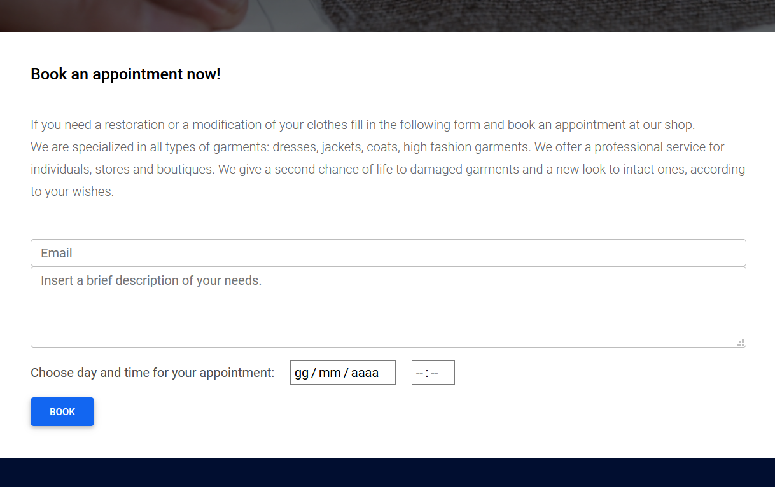
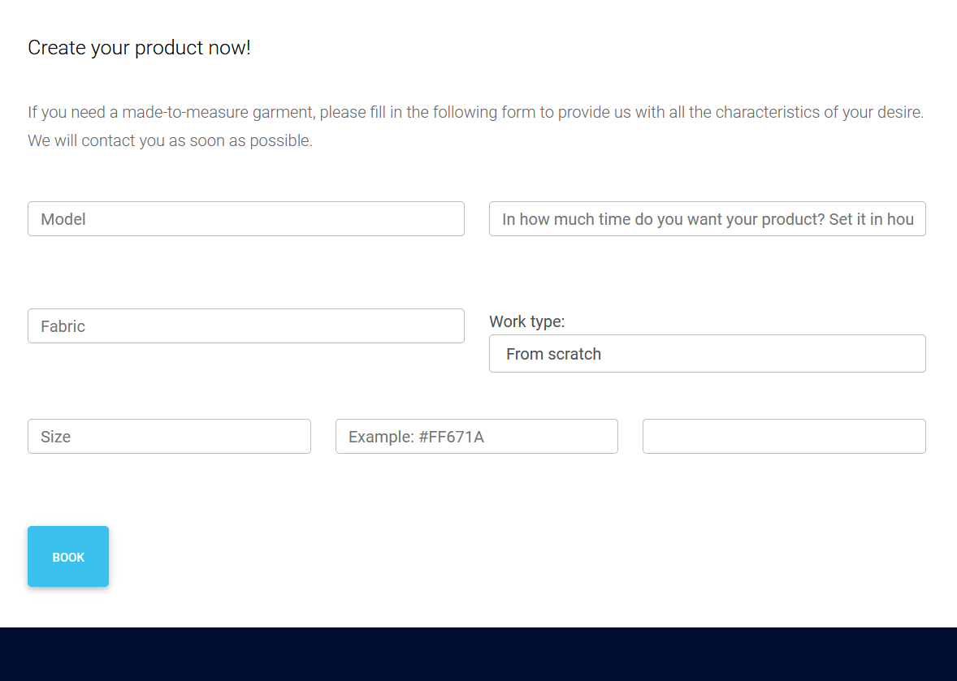
Frontend - Client Side 3
The user can also:
Create a custom product
Book an appointment
Web Application
Academic Year 2020-2021
Dallapellegrina Elia, Friso Luca, Golmohammadi Pargol,
Grimaldi Alberto, Mjama Anass

Slide 9
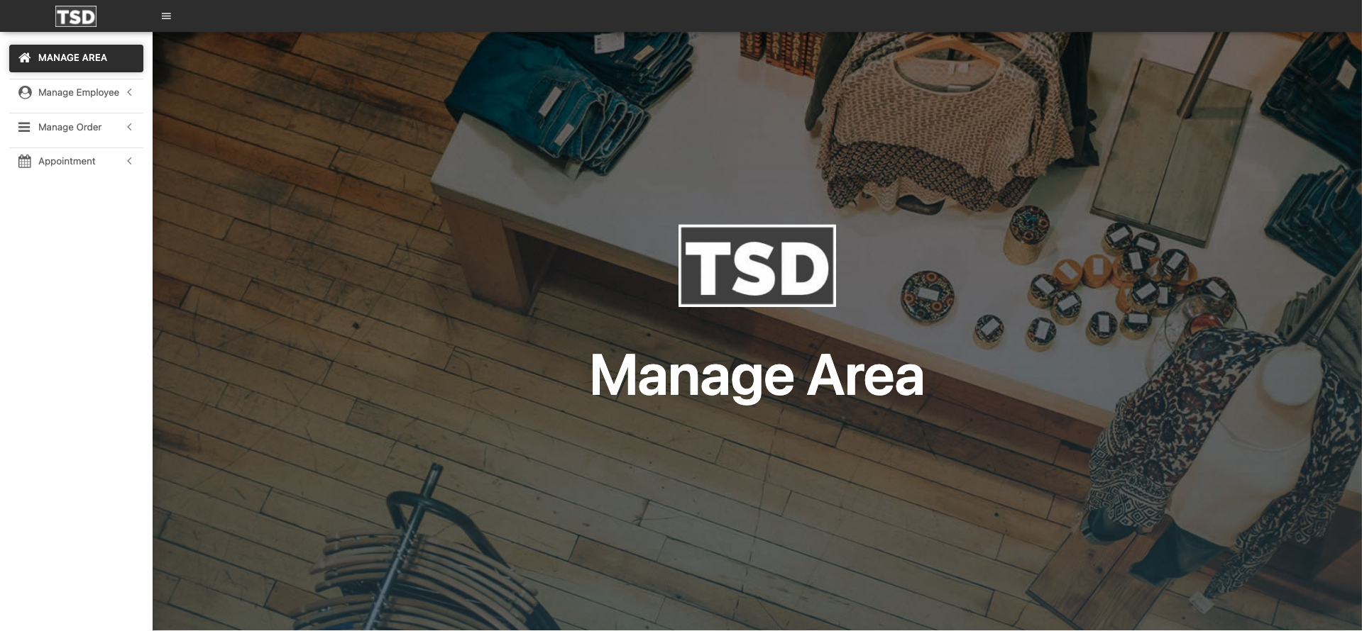
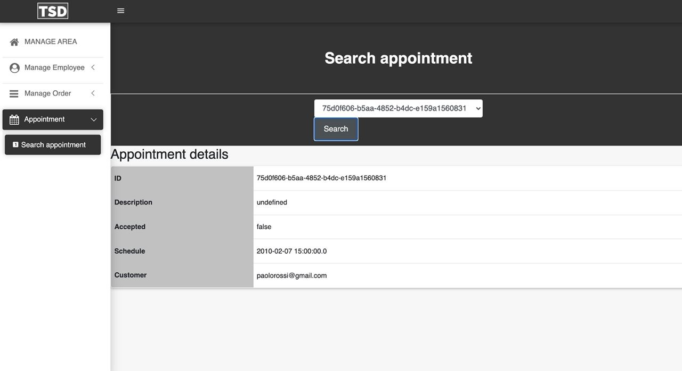
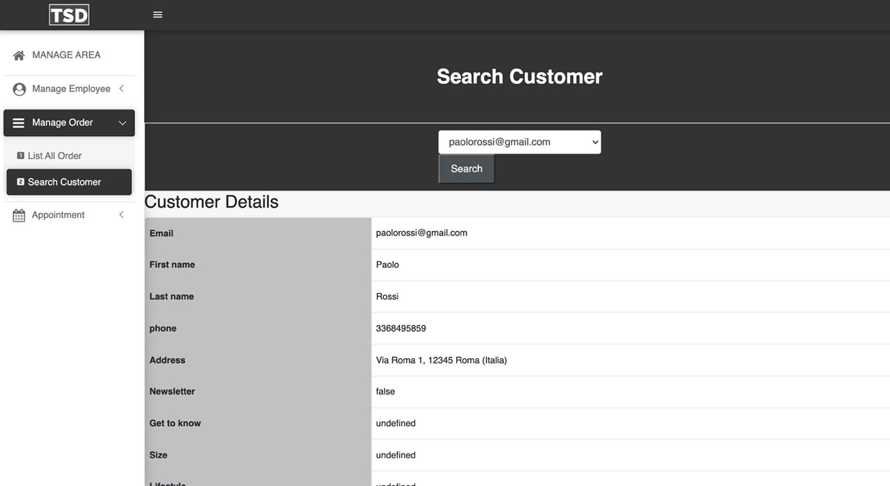
Frontend - Manager/Employee Side 1
Check orders and manage them
Check appointments and manage them
Check info about the customer
Managing employees
Web Application
Academic Year 2020-2021
Dallapellegrina Elia, Friso Luca, Golmohammadi Pargol,
Grimaldi Alberto, Mjama Anass

Slide 10
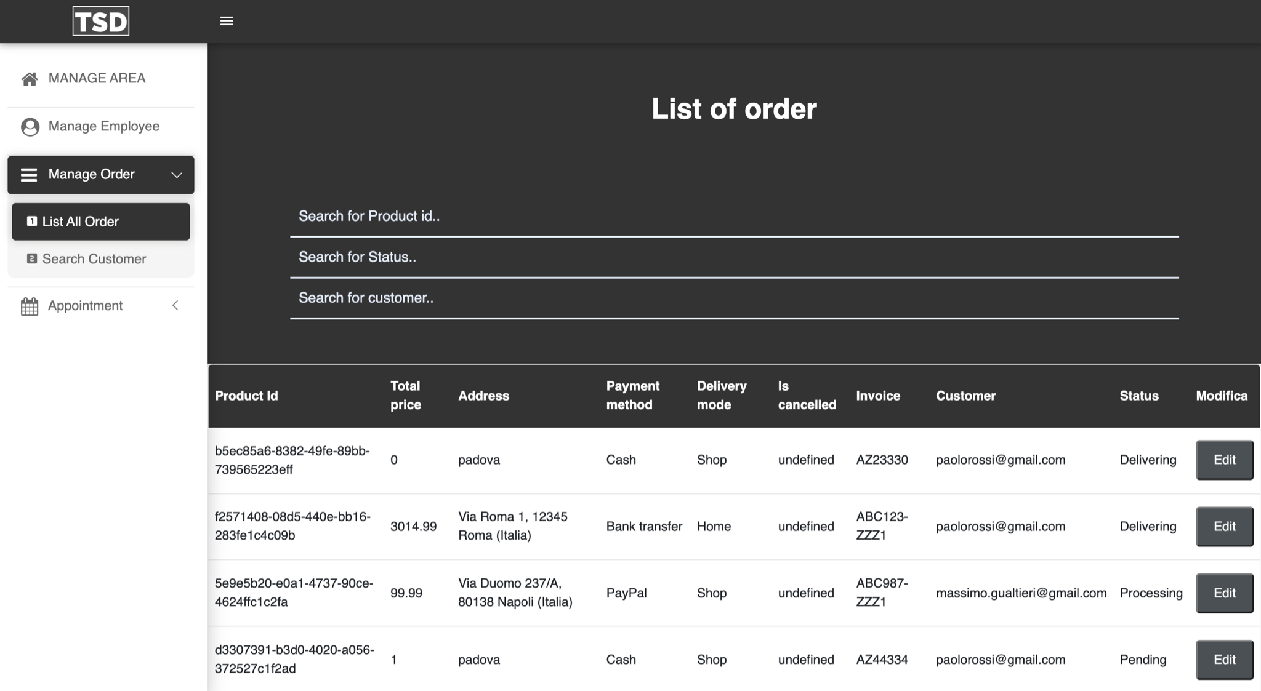
Frontend - Manager/Employee Side 2
What can we do in the search page?
search for id
search for status
search for customer
Web Application
Academic Year 2020-2021
Dallapellegrina Elia, Friso Luca, Golmohammadi Pargol,
Grimaldi Alberto, Mjama Anass

